Slide 1
Snowflake
Elan Shanmugam
Notes:
"Hello everyone, and welcome to this session on Snowflake. today, I’m going to give you a quick introduction to what Snowflake is and why its preferred SAAS tool in cloud data warehousing world. Let’s go over the key points about Snowflake."

Slide 2
Introduction
Founded in 2012, cloud native data platform that provides SAAS offering for Data warehousing and analytics
Decoupled Compute & Storage for scalability.
Multi-cluster warehouse for concurrency
Fully managed (No Admin Overhead)
Supports structured and semi-structured data
Built in security compliance
Time travel & Fail Safe
Data Sharing and collaboration
Pay as you go pricing
Unified analytics and AI/ML Integration
Notes:
Cloud-Native SaaS Platform
“founded in 2012 Snowflake is a fully managed cloud-based data warehouse available on AWS, Azure, and Google Cloud. There’s no hardware to manage, and it scales automatically."
Separation of Compute & Storage
"Unlike traditional databases, it separates compute from storage, so we can scale them independently based on our needs."
Multi-Cluster, High Concurrency
"Snowflake supports multiple virtual warehouses which means multiple warehouse runs in parallel and one query doesn’t interfere with query in different warehouse."
Fully Managed
“We don’t need DBA’s to manage administrative tasks like indexing, partitioning, or database tuning—Snowflake takes care of all performance optimizations tasks in the background."
Supports Structured & Semi-Structured Data
“We can load structured data as well as semi-structured data like JSON, Parquet, and Avro. No need to do complex transformations."
Security & Compliance
“From security stand point it provides end-to-end encryption which includes encryption in transit and support for compliance standards like GDPR, HIPAA, and SOC 2."
Time Travel & Fail-Safe Recovery
“They have feature called Time Travel, using which we can query historical data to recover lost information from there or use it in query, there is also another feature called Fail-Safe which provides an extra layer of data protection in case server goes down."
Data Sharing Without Copying
“We can also share data instantly across different accounts without having to duplicate "
Cost-Efficient, Pay-as-You-Go Model
"With per-second billing, we pay for what we use."
AI/ML & BI Tool Integration
"Snowflake is integrated with Python, Snowpark, and business intelligence tools like Tableau and Power BI”
[Closing Statement]
“To summarize, its a powerful, scalable, and easy-to-use cloud data platform. As we go through this presentation, we’ll get more understanding of its architecture, pricing, and key features. Let’s get started!"

Slide 3
Pricings & Regions
Consumption based pricing Strategy.
Storage costs: ~$23/TB/Month (Compressed)
Compute costs: Pay per second(Virtual Warehouses)
Data Transfer: Free within region, $0.02-$0.09 per GB cross-region/cloud
Extra Features: Snowpipe, Materialized views, SOS, QAS e.t.c
https://www.snowflake.com/en/data-cloud/pricing-options/
Notes:
• “Now, let’s talk about Pricings & Regions. One of Snowflake’s advantage like any other cloud provider is its consumption-based pricing model, which means we only pay for what we use. This makes it more cost-efficient and being in the cloud helps it be scalable. Let’s break down pricing components.”
• First, Consumption-Based Pricing:
• “As I told before, unlike traditional databases where we get charged based on fixed resources, Snowflake charges based on actual usage. We only pay for the compute and storage WE consume.
• Next is Storage Costs:
• “Snowflake stores data in a compressed format called micropartitions(if think table as library then Bookshelfs is a micropartition storing related books together) and helps us reduce the costs. The current rate is $23 per terabyte per month”
• Then Compute Costs:
• “Computing in Snowflake is handled by Virtual Warehouses(Restaurant Chefs and Kitchen), which get billed per second. We can scale them vertically (Adjusts the size of warehouse (XS, S, M, L) as well as horizontally (Increase or decrease the number of compute clusters), and we get billed for the time our compute resources which are active.”
• Finally Data Transfer Costs:
• “Snowflake offers free data transfers within the same region, but cross-region or cross-cloud transfers they charge which runs roughly between $0.02 to $0.09 per GB, based on the destination.”
• Extra Features:
• “There is also additional cost-based features like:
• Snowpipe which offers real-time data ingestion
• Materialized Views for faster query performance. It’s a precomputed view of data stored in a table-like structure
• Search optimization service applies filters to prune unnecessary micro partitions from the query to optimize performance. SOS (Search Optimization Service) make searching and filtering fast by pruning unnecessary micro partitions during query execution. QAS(Query Acceleration Service) speeds up large complex queries by adding extra compute.
“So, in summary, You only pay for what you use and there are tons of features”

Slide 4
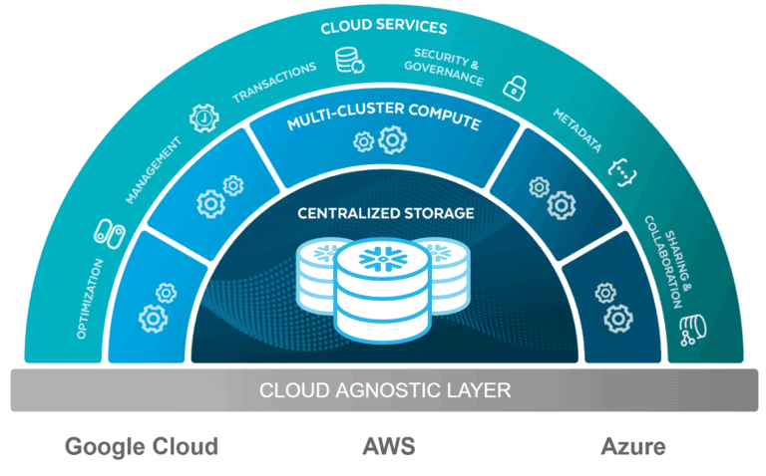
Architecture
Layer | Description
Storage layer | Stores all data (Structured and Semi-Structured) in columnar format
Compute layer | Handles Query execution and data processing
Cloud service layer | Manages metadata, Security, Query Optimization and Orchestration
Notes:
Snowflake’s architecture is built on three distinct layers—Storage Layer, Compute Layer, and Cloud Services Layer—each playing role in how Snowflake manages and processes data.
First Storage Layer. Snowflake keeps all our data in one central spot, fully managed and optimized. It can handle both structured data (like traditional tables) and semi-structured data (like JSON, Avro, ORC, and Parquet). Unlike traditional databases, Snowflake stores data in a compressed, columnar format, boosting performance while saving storage costs. This layer scales automatically, so Snowflake takes care of data distribution and compression without us needing to do work on it.
Next up is the Compute Layer, where all the query execution and data processing magic happens. In Snowflake, compute resources are called Virtual Warehouses—these are independent compute clusters that can scale up or down based on the workload. Since Snowflake’s compute layer is separate from storage layer, multiple workloads can run at the same time.
Just like the Storage Layer, Virtual Warehouses can scale elastically and independently, with fast query execution even during peak times. Plus, we can manually/automatically suspend idle warehouses to save cost when they’re not in use.
The third piece is the Cloud Services Layer. This is the brain of Snowflake, handling metadata, security, query optimization, and orchestration. Every query we send to Snowflake goes through this layer, where it gets analyzed and optimized for execution. This layer also takes care of automatic performance tuning by creating the best execution plan for your queries.
When it comes to security, they have end-to-end encryption, multi-factor authentication, and role-based access control. It also offers automatic failover, replication, and governance.
To sum it up, Snowflake’s architecture gives you elastic storage and compute, along with robust cloud services.

Slide 5
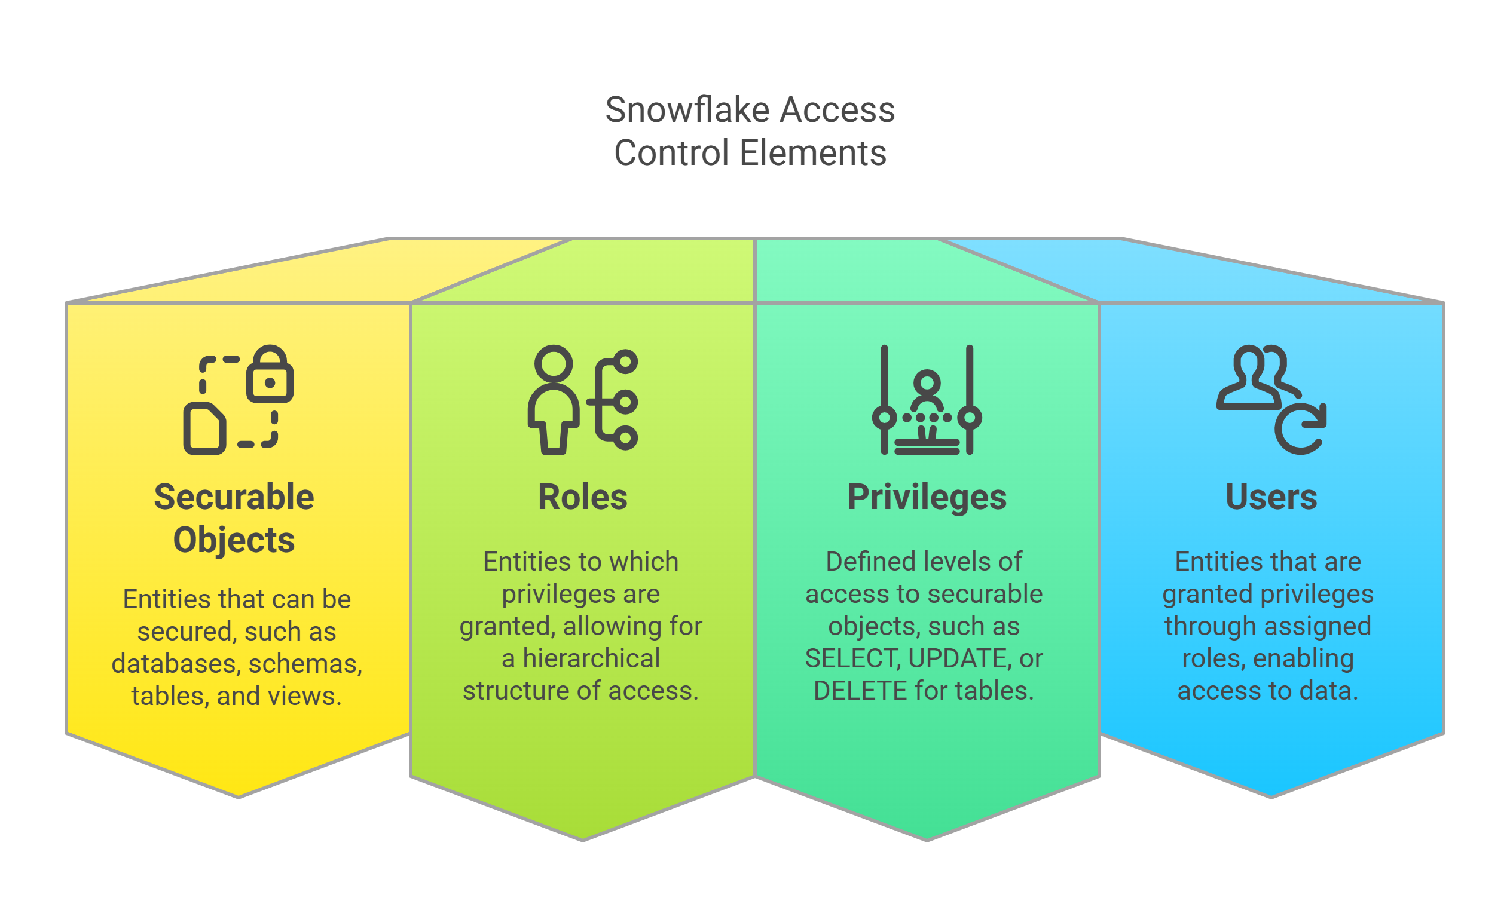
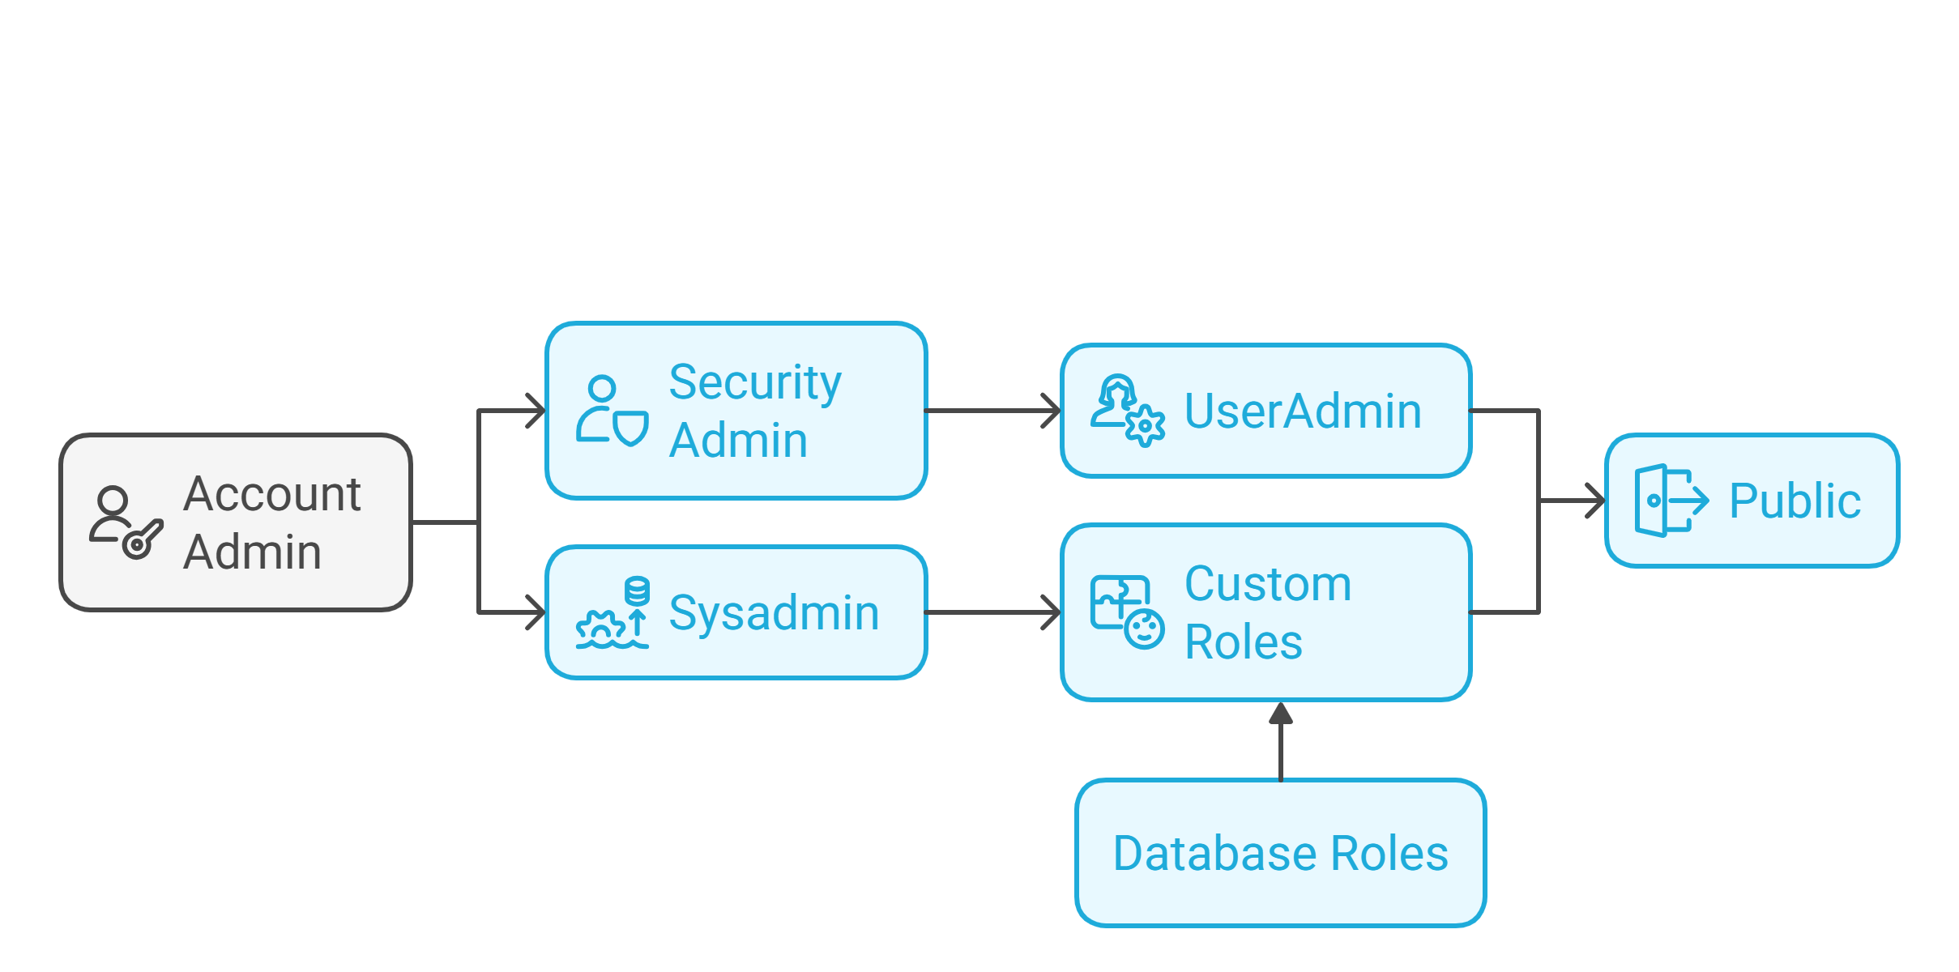
Access Control
Role based Access Control (RBAC) and Discretionary Access Control (DAC)
Custom Roles & Privileges Management
Multi-Factor Authentication & SSO
Row & Column-level security.
Notes:
"Snowflake divides access control to Role-Based Access Control (RBAC) and Discretionary Access Control (DAC). This two control policy decides who can access and modify data. This two control model sits on top of these four foundational control key elements.
Securable Objects includes databases, schemas, tables, views e.t.c.
Roles are assigned/assumed privileges that can be granted to users or even to other roles.
Privileges – These define what actions can be performed on securable objects, such as SELECT, UPDATE, or DELETE on a table.
Users – These are the actual individuals or applications granted access through roles.
Now, let’s dive deeper into Role-Based Access Control, or RBAC.
RBAC simplifies access management by grouping users into roles. Instead of assigning permissions to individual users, Snowflake assigns them to roles, which users then inherit.
Roles are created with specific privileges.
Users are assigned to these roles, automatically inheriting the associated permissions.
Roles can be nested, meaning one role can be part of another, allowing granular access control.
For example, a data analyst role might have read-only access to certain datasets, while a data engineer role will have permissions to modify and manage those datasets.
Next, we have Discretionary Access Control, or DAC. Unlike RBAC, DAC empowers object owners to control access.
Each securable object has an owner who decides which roles can access it.
Owners have the flexibility to grant or revoke permissions as needed.
DAC is useful when fine-grained, case-by-case access control is required, allowing teams to collaborate while maintaining data security.
Now, let’s talk about some key security features in Snowflake’s access control model:
By default, access is denied unless explicitly granted.
Roles follow a hierarchical structure, making it easy to scale access control as an organization grows.
Users can switch between roles, but it’s recommended to set default roles to avoid unintended access.
Network policies help restrict account access to specific IP addresses, adding an extra layer of security.
To enforce this model effectively, Snowflake provides several predefined roles with specific responsibilities. Let’s go over them:
ORGADMIN (Organization Administrator) – This role manages multiple Snowflake accounts under an organization. It controls billing, account creation, and security policies at a high level.
ACCOUNTADMIN (Account Administrator) – The top-level role within a Snowflake account. It has full control over warehouses, databases, and account settings, but it’s not recommended for daily use due to its broad permissions.
SECURITYADMIN – This role is focused on security and access management. It controls user creation, role management, and network policies, making sure only authorized access the resources.
USERADMIN – Dedicated to managing users and roles but does not have control over object
SYSADMIN – Used to manage databases, schemas, Virtual warehouses in snowflake. It can create, modify drop objects but can’t manage users or roles(that’s for Security admin). It’s the go to role for managing data processing resources.

Slide 6
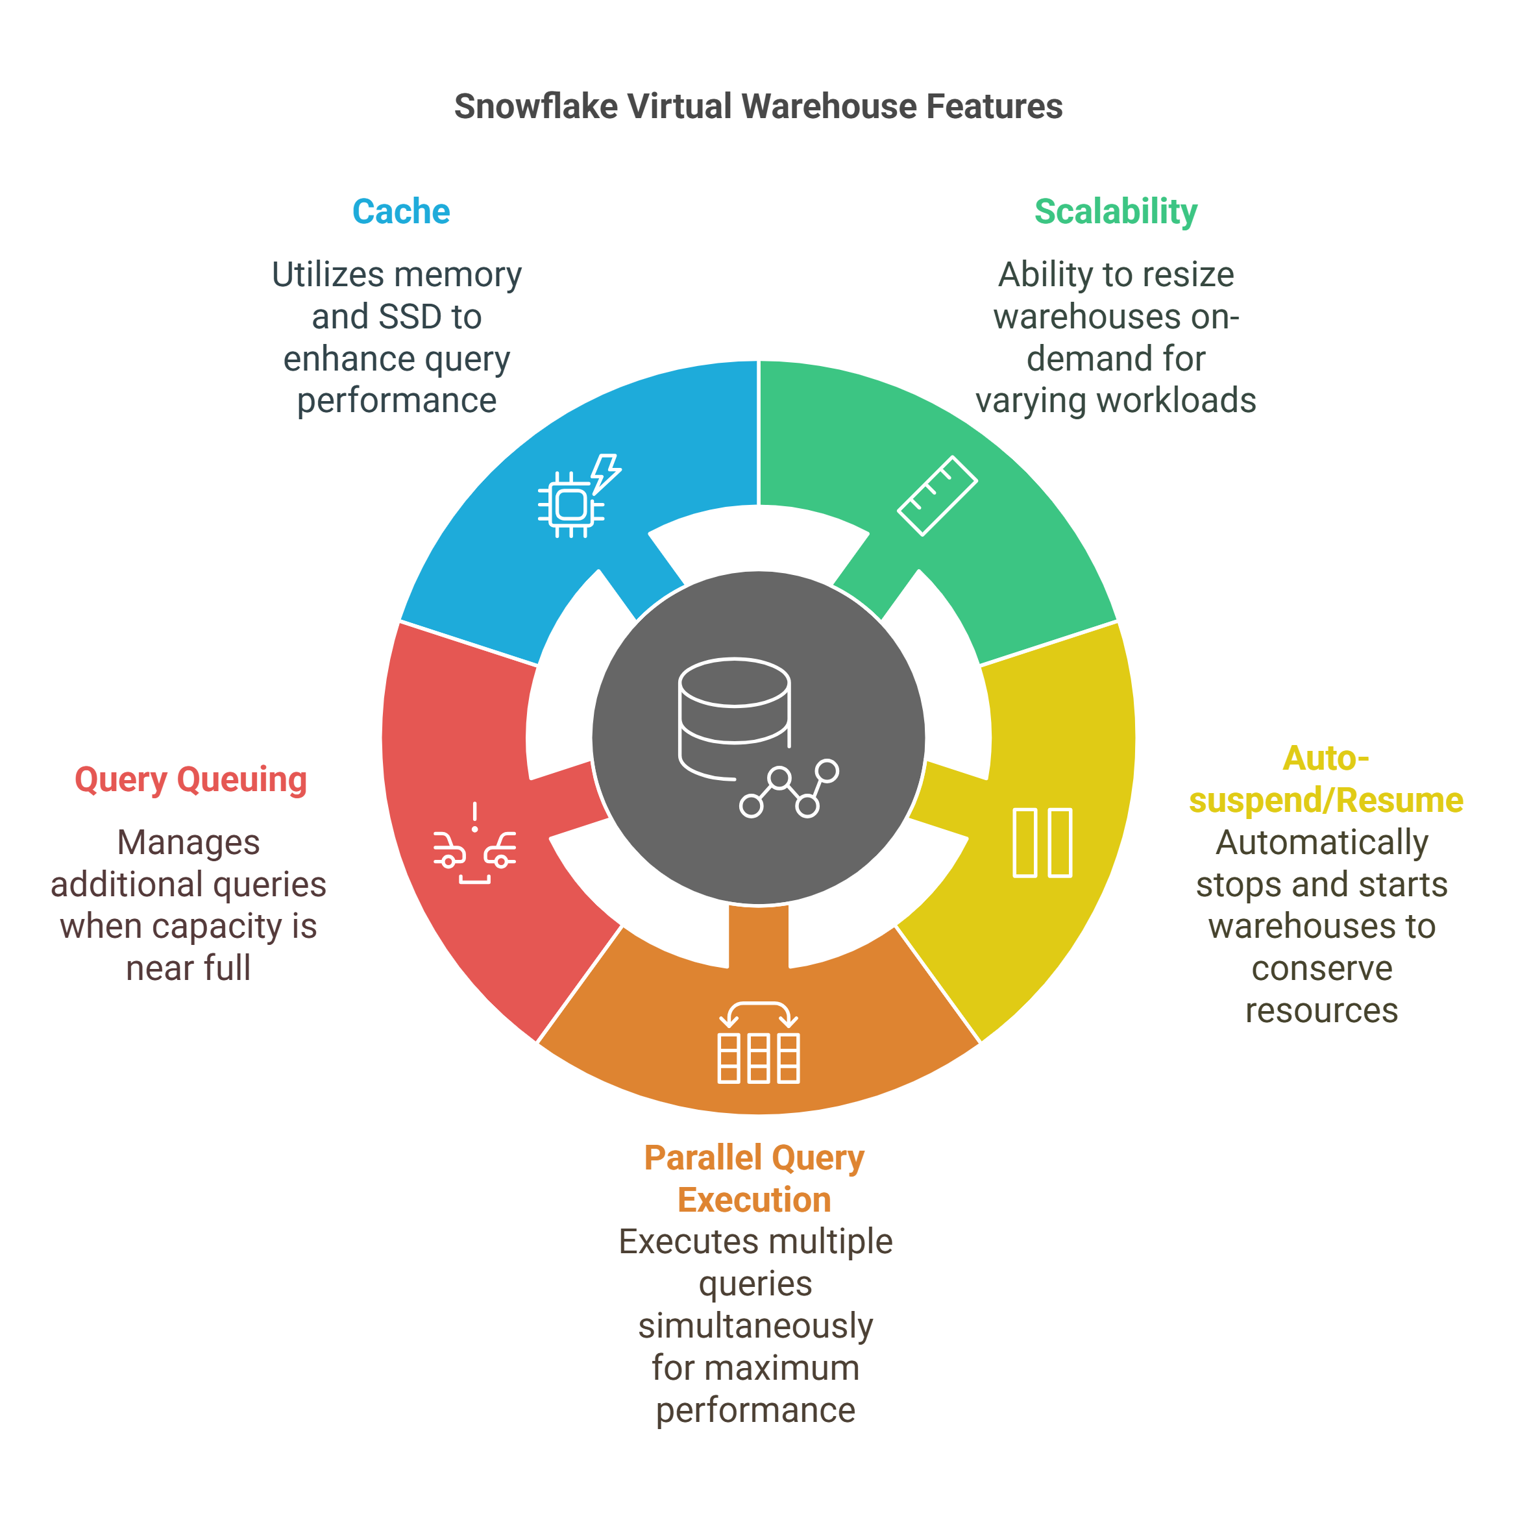
Virtual Warehouse
Standard vs Snowpark- Optimized.
Warehouse size from x-small – 6x large.
Multi-Clustering (maximized vs Auto-scale)
Query Acceleration Service (QAS)
https://docs.snowflake.com/en/user-guide/warehouses-overview
Notes:
“Now the most powerful components of Snowflake—the Virtual Warehouses. Think of it as the compute engine that delivers query execution and data processing in Snowflake. Whether we’re running simple queries or handling massive workloads, Virtual Warehouse takes care of scalability and performance.
So, what exactly is a Virtual Warehouse? At its core, it’s a cluster of compute resources which executes SQL queries and performs data operations. It’s completely separated from storage, meaning we can scale our compute power independently based on your workload.
Structure and Functionality
A Virtual Warehouse consists of multiple compute nodes, each with:
8 CPU cores
Allocated memory
SSD storage for caching
Virtual warehouses spin up within milliseconds and scale automatically as needed.
Key Features of Virtual Warehouses
Scalability – We can resize Warehouses vertically (increasing size) or horizontally (adding clusters).
Auto-Suspend & Auto-Resume – Warehouses automatically stop when idle and restart when a query is submitted. This helps us save some credits and reduces costs.
Parallel Query Execution – A single warehouse can run multiple queries in parallel, in other words workload distribution.
Query Queuing – When workload reaches 100% capacity, additional queries are queued automatically to maintain smooth performance.
Cache Optimization – Snowflake uses memory and SSD as a query cache, this option helps repeated query execution.
Warehouse Sizes and Scaling
Two Types – Standard and Snowpark optimized
Virtual Warehouses come in different sizes, ranging from X-Small (8 CPUs) to 6X-Large. As size increases, more compute resources are allocated, reducing query execution time and handling larger workloads.
Another powerful feature is Multi-Clustering. This comes in two modes:
Maximized Mode – Ensures all available clusters run simultaneously for peak performance.
Auto-Scale Mode – Clusters starts and stop automatically based on workload
Standard vs. Snowpark-Optimized Warehouses
As of 2025, Snowflake offers two types of warehouses:
Standard Virtual Warehouses – Suitable for most workloads, including reporting and analytics.
Snowpark-Optimized Warehouses – Designed for memory-intensive workloads, like machine learning training, ensuring efficient large-scale processing.
Query Acceleration
Snowflake also provides Query Acceleration (car race video game), which dynamically boosts compute power for complex queries, reducing wait times and improving performance.
Final Thoughts
In summary, Snowflake’s Virtual Warehouse is a highly flexible, scalable, and cost-efficient compute engine that can adapt to any workload. With features like auto-scaling, caching, parallel execution, and Snowpark optimization, it ensures fast and reliable query processing while keeping costs under control.
Thank you for joining me in this deep dive into Virtual Warehouses. Now, let’s move on to how we can optimize performance and cost efficiency when using them in real-world scenarios!"

Slide 7
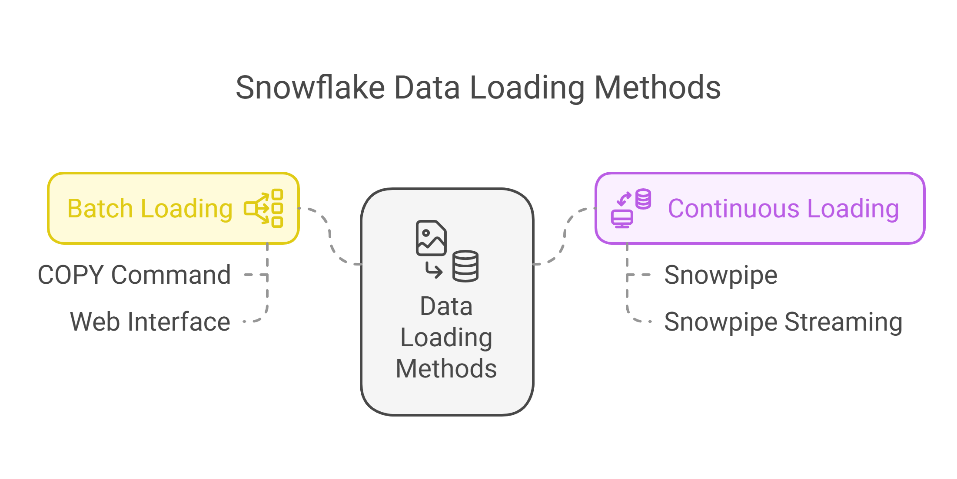
Data Loading
Buld Load COPY Into <table> from internal/external stage
Continuous load: Snowpipe (Serverless)
File Formats : JSON, Parquet, Avro, ORC, CSV, XML
Notes:
Data Loading. How do we get data into snowflake. There are two methonds
Let's start with Batch Loading. There are two ways. First up is the COPY Command. Think of it as a powerful SQL command that bulk loads large amounts of data quickly. We can load single file up to 1 TB, but industry standard is using it for multiple files around 100-250 MB compressed.
Next, we have the Web Interface. This option user-friendly and ideal if you’re dealing with small or medium-sized files—up to 50 GB. It’s all point-and-click, which works great for ad hoc data loading without writing into SQL commands. Basically, we just drag and drop the file and it workss.
Now, the other side, Continuous Loading. The first method here is Snowpipe. Snowpipe automatically loads data as soon as it finds file in our cloud storage. It’s completely serverless, so we don’t have to worry about managing infrastructure. And the best part? Data is available within minutes, so we can start querying almost immediately.
For even faster high-throughput needs, there’s something Snowpipe Streaming similar to kafka. This method allows us to directly ingest rows from our applications or event streaming platforms where we need lowest possible latency. It’s all about getting our data in real-time to the dashboards.
So to wrap it up: If you’re handling large files or doing bulk uploads, go with the COPY Command or Web Interface depending on your file size. But if you need data in near real-time, Snowpipe and Snowpipe Streaming are your best bets.

Slide 8
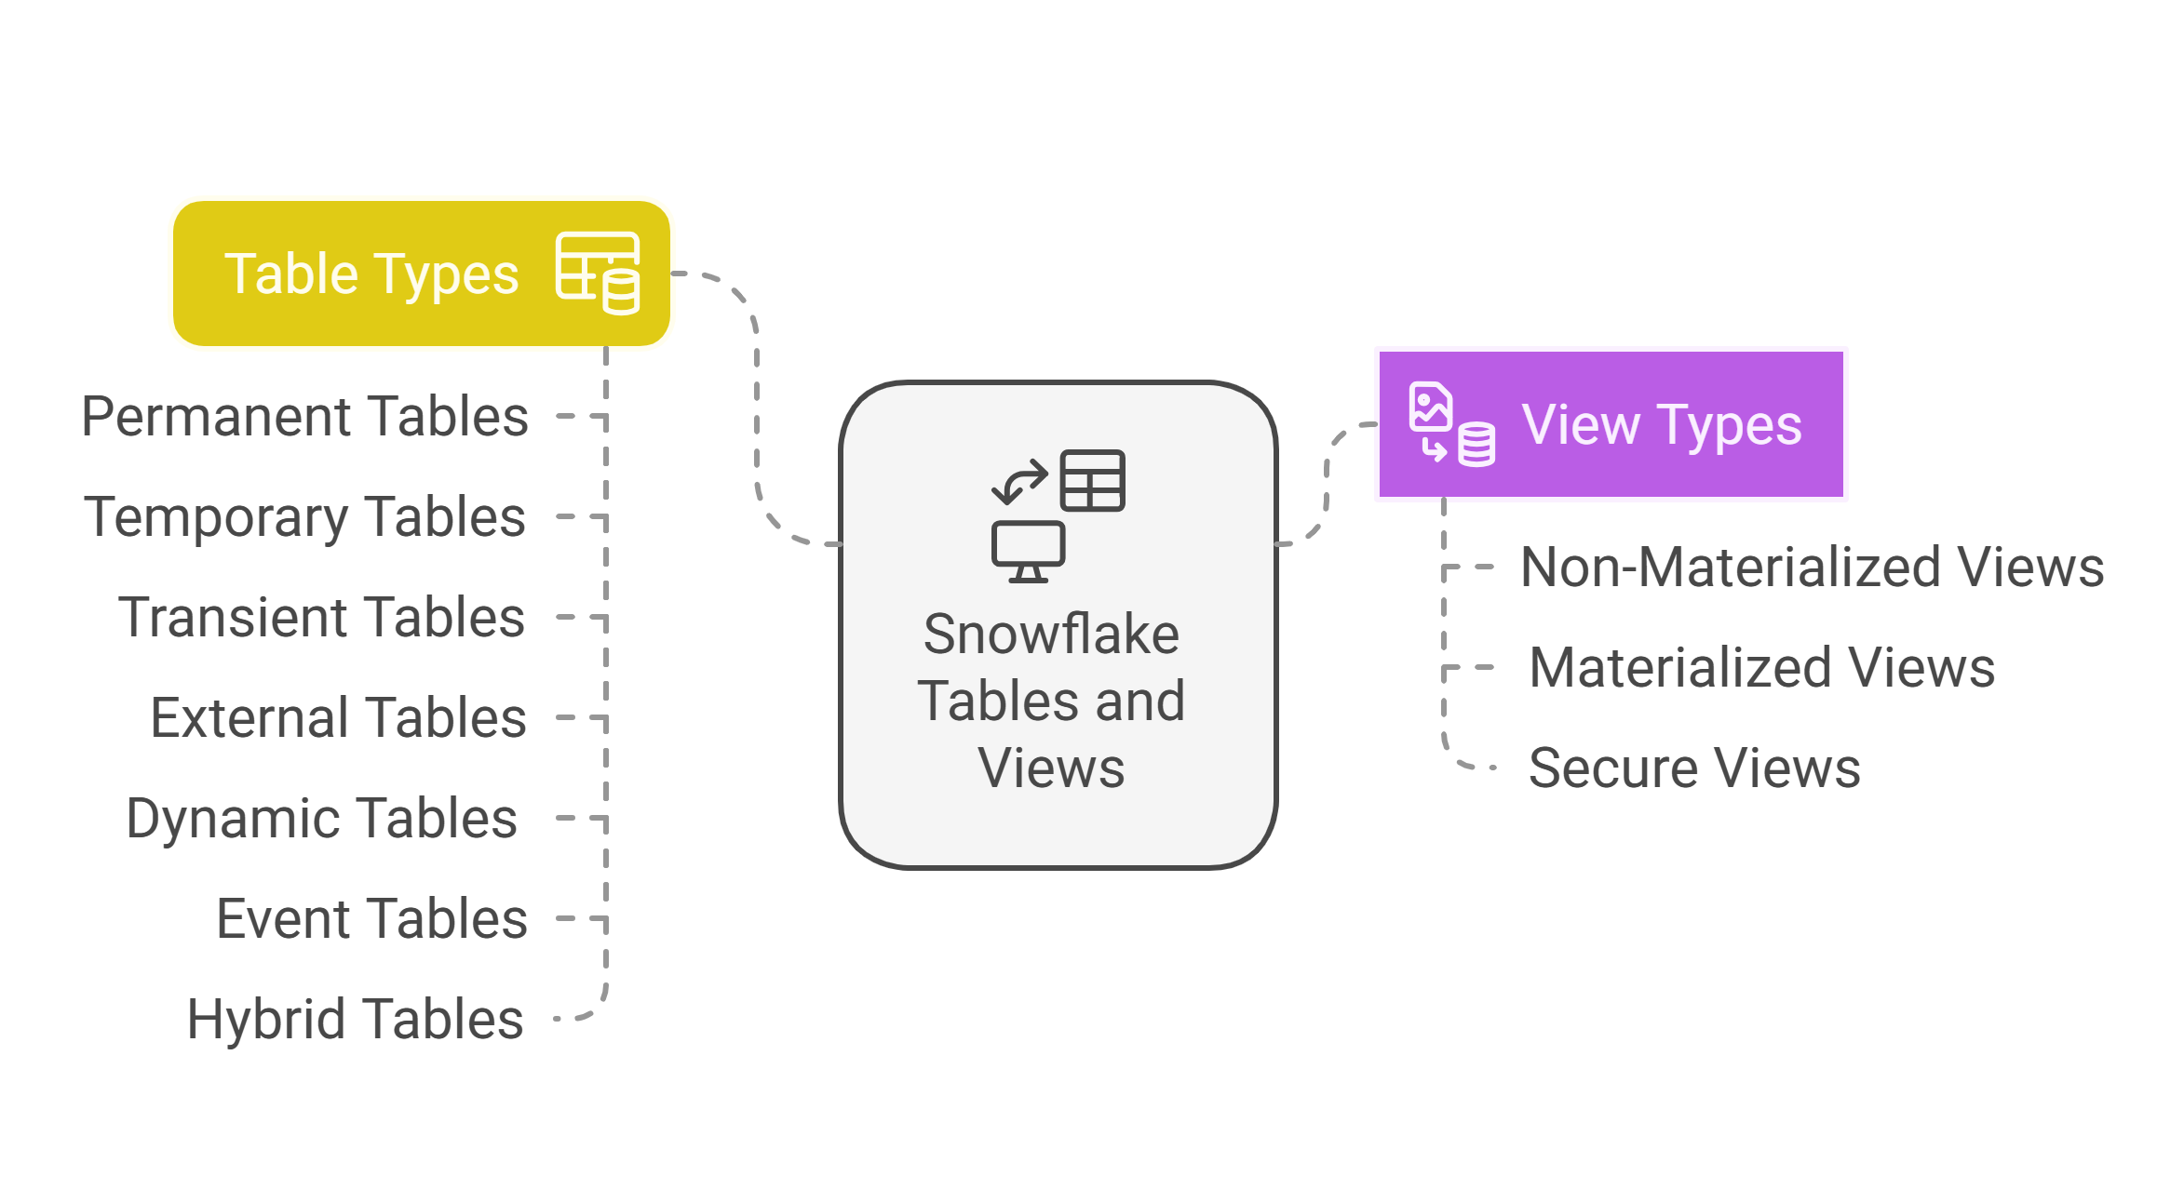
Tables & Views
Notes:
Moving on to Tables and views:
Tables in Snowflake
Snowflake offers several types of tables, each designed for different needs. Let’s start with the basics.
1. Permanent Tables default is 1 day but can be extended to 90 days. Fail safe is 7 days.
These are the standard tables in Snowflake. Its persist data indefinitely until deleted. This table supports Time Travel and Fail-safe, meaning we can recover lost data if needed. These are great for long-term storage of table data.
2. Temporary Tables. No faile safe, time travel upto 1 day
As the name suggests, these tables exist only for the duration of a session. Once the session ends, they’re automatically dropped. They’re perfect for staging or intermediate data processing when persistence isn’t required.
3. Transient Tables: No Fail safe, time travel upto 1day
Similar to permanent tables, but they do not have Fail-safe. That means lower storage costs but less recovery protection. These are useful when you need persistent data but don’t require long-term recovery features.
4. External Tables: No fail safe or time travvle
Unlike other tables, external tables store only metadata, while the actual data remains outside Snowflake, in cloud storage like AWS S3 or Azure Blob. These tables allow you to query data directly from cloud storage without loading it into Snowflake, making them ideal for data lakes and hybrid architectures.
5. Dynamic Tables
Think of these as automated materialized views. Dynamic tables can automatically refresh their data based on defined schedule trigger
6. Event Tables
Designed for streaming data ingestion, They are similar to dynamic tables but they are designed to automatically refresh based on event
7. Hybrid Tables (New in 2024, Preview Mode)
Snowflake is evolving! Hybrid tables enable low-latency reads and writes, making them ideal for transactional (OLTP) workloads alongside analytics (OLAP). operational and analytical workloads in a single platform. Insert Update Delete
Views in Snowflake
Now, let’s talk about Views, which provide a way to query data without duplicating it.
1. Standard Views
These are logical views that store only the query definition, not actual data. They’re useful for simplifying complex queries without additional storage costs.
2. Secure Views
A variation of standard views, Secure Views protect query logic from unauthorized access. If you need stronger security controls, such as hiding column calculations or business logic, this is a great choice. Other side can’t view the Query definition of the Secure views.
3. Materialized Views
Unlike standard views, Materialized Views store precomputed results. This speeds up queries but incurs storage costs. They’re ideal when you need faster performance for frequently used queries.
Final Thoughts
Choosing the right table or view depends on your workload and business needs. Whether you need persistent storage, real-time data processing, or faster queries, Snowflake provides flexible options to meet those requirements.
I hope this breakdown helps you understand how to best utilize Snowflake’s Tables and Views. Thanks for joining, and let’s move on to some best practices for managing them efficiently!"

Slide 9
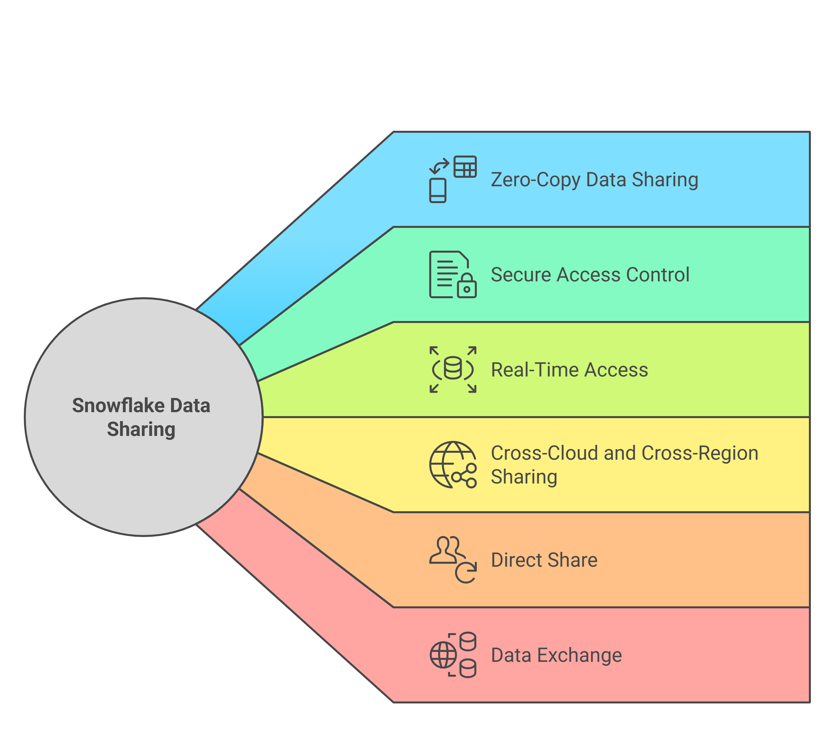
Data Sharing
Types of Data Sharing
Direct Share
Data Exchange
Snowflake data marketplace
Notes:
"“Lets move on to—Data Sharing. In traditional systems, sharing data often involves copying and moving files, we get higher storage costs, data inconsistencies, and security risks. To avoid this snowflake has the feature called Zero-Copy Cloning/sharing.
Key Features of Snowflake Data Sharing
1. Zero-Copy Data Sharing
One of the biggest advantages of Snowflake is that data is shared without physical duplication. This means:
No extra storage costs.
No outdated or redundant copies.
Consumers always access the latest version of the data.
2. Secure Access Control- Secure Views
We talked about Access control, Snowflake offers fine-grained access control, meaning data providers could specify exactly what data is shared and with whom. And don’t worry—all data is encrypted, both in transit and at rest.
3. Real-Time Access
Instead of waiting for periodic updates, recipients can query shared data in real-time. This is game-changing for businesses that need up-to-the-minute insights for decision-making.
4. Cross-Cloud and Cross-Region Sharing
Snowflake enables seamless data sharing across different cloud providers (AWS, Azure, GCP) and across different regions. This means you don’t have to worry about data transfers or compatibility issues—Snowflake handles everything in the background.
Types of Data Sharing in Snowflake
Now, let’s explore the different ways you can share data in Snowflake.
1. Direct Share
This allows you to share specific database objects with another Snowflake account. You can share data one-to-one or one-to-many while maintaining full control over access permissions.
2. Data Exchange
This feature allows you to create a private data marketplace, where multiple consumers can access and use shared datasets. It’s ideal for organizations that need to collaborate internally or with partners.
3. Listings (New in 2024)
Snowflake now offers Listings, an enhanced version of data sharing that includes metadata, documentation, and controlled access. Listings allow you to share data publicly or privately, making it easier to manage and distribute datasets.
4. Snowflake Data Marketplace
This is a public marketplace where businesses can buy and sell datasets across different industries. Whether you need financial data, weather trends, or healthcare analytics, you can find trusted datasets from multiple providers.
Final Thoughts
Snowflake’s Data Sharing capabilities provide a secure, cost-effective, and real-time way to collaborate with data. Whether you’re sharing within your organization, across different accounts, or monetizing data, Snowflake makes it effortless.
Thanks for joining, and let’s move on to best practices for managing data sharing efficiently!"

Slide 10
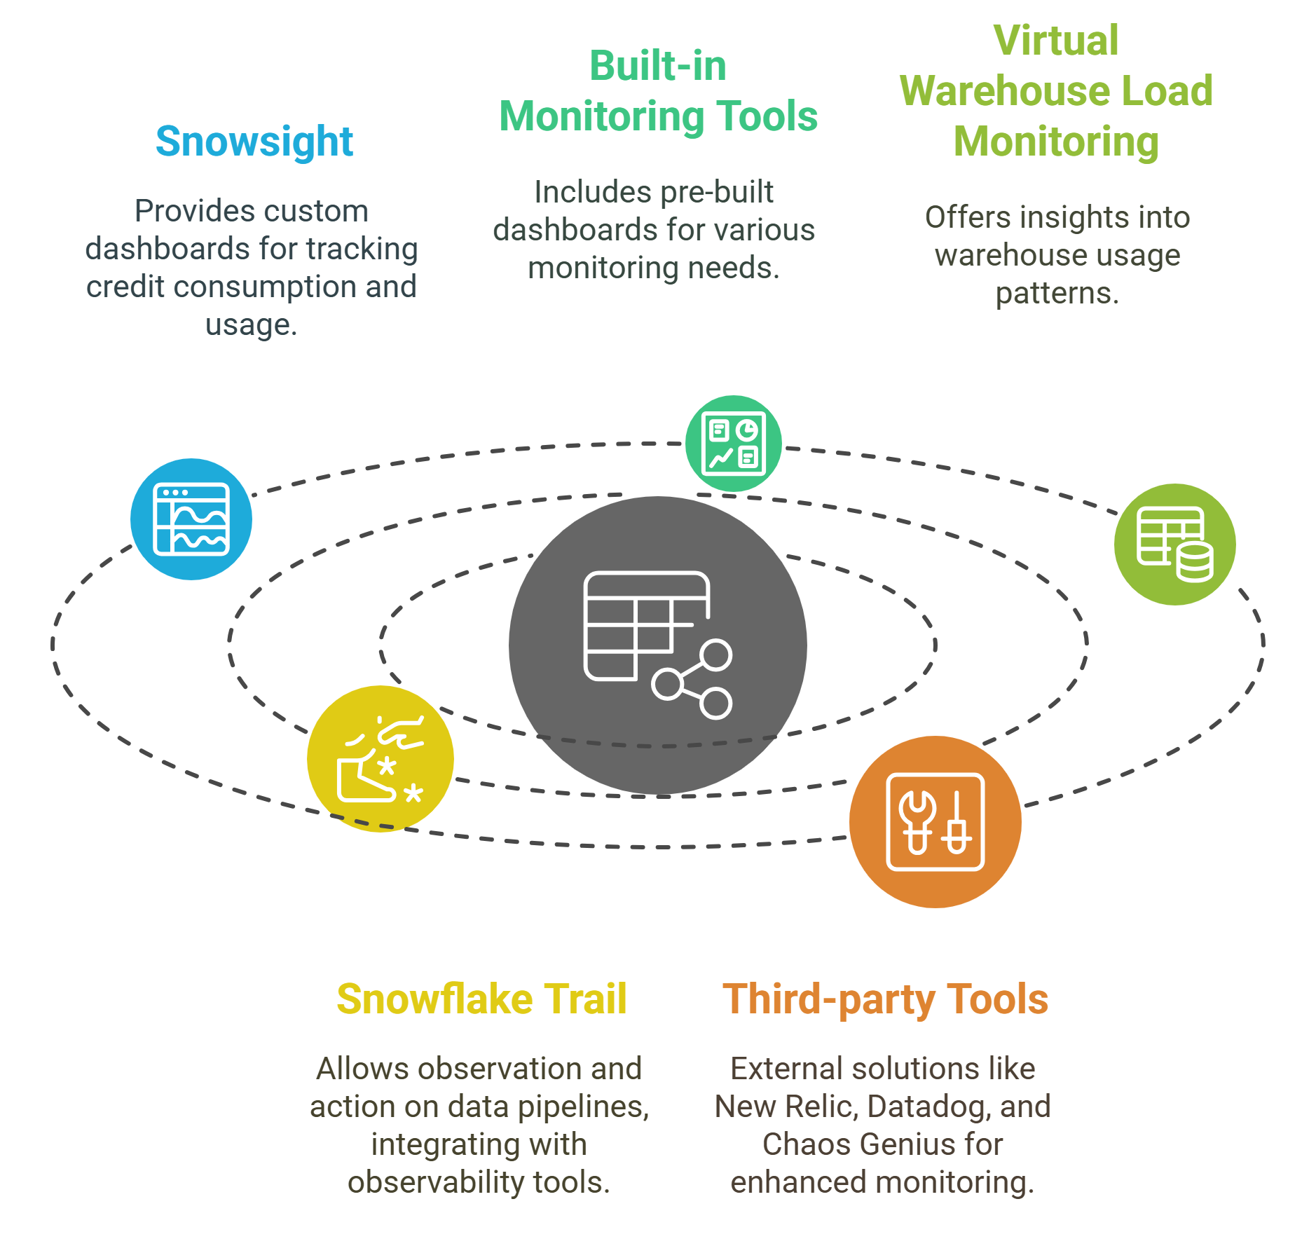
Monitoring
Query History & Performance Profiling
Resource Monitors (Cost Control)
Account_Usage & Information_Schema Views
Usage Dashboard (Compute, Storage, Query Execution)
https://www.sigmacomputing.com/resources/library/snowflake-performance-monitoring
Notes:
Finally, Snowflake's got some cool tools to help us keep an eye on how things are running and what they're costing us. First up, there's Snowsight, their web interface that lets you set up custom dashboards to track how many credits we’re are using and what our usage looks like across different areas.
They've also built in some monitoring tools with ready-made dashboards. These let us see what's happening in our account, how many credits we're using, how much storage we're taking up, and how our queries are performing. For our virtual warehouses, there's a load monitoring chart that shows us both current and past usage patterns. In 2024, they rolled out Snowflake Trail. It's a set of features that lets developers and data engineers keep tabs on their applications and data pipelines. We can also integrate it with Datadog, Grafana, and PagerDuty. There are also some third-party tools that can give you a hand:
New Relic: This one gives you real-time insights into Snowflake's performance, costs, security, and availability. It keeps an eye on key metrics like how our queries are doing, how many credits we’re using, how much storage we are consuming, and any failed logins.
Chaos Genius: Another tool used for cost exploration, query recommendations, and warehouse optimization features. It's great for diving deep into your Snowflake usage and finding ways to make things run smoother and cheaper.

